Slide 1

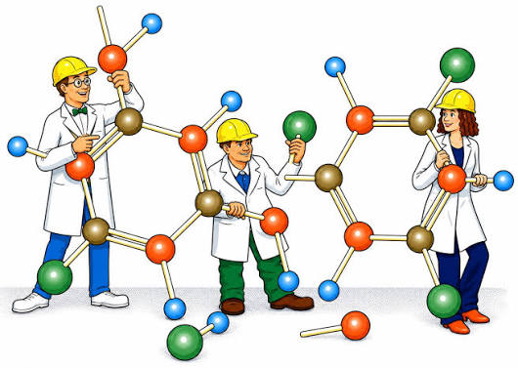
Molecular Mechanics, Modeling and Electron Structure Method
Kwame Nkrumah University of
Science & Technology, Kumasi, Ghana
CSSCML 2026 WORKSHOP

Slide 2
Outline
Introduction to Computational Chemistry
Quantum Mechanical Methods
Molecular Mechanics (MM)
Advantages and Limitation of MM
Potential Energy Surfaces (PES)
Energy Profile Diagrams (EPD)
Basis Sets
Solving a problem (goal)/Application
What We Do?
Hands-on Session

Slide 3
Computational Chemistry
What is Computational Chemistry?
Use of computers to help solving chemical problems (calculate the structures, properties, geometries, and reactions of molecules and solids.)
Chemical problems
Computer programs
Physical Models
Math Formula

Slide 4
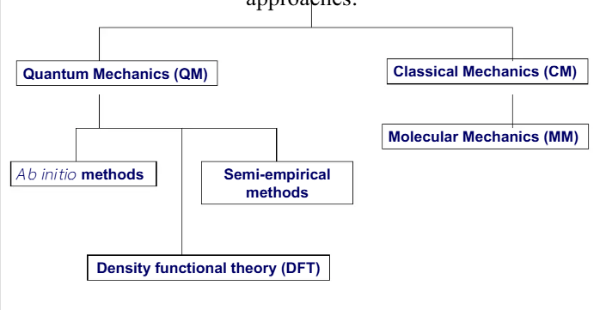
Computational Tools

Slide 5
Quantum Chemical Methods
Th e most commonly used quantum chemistry methods are:
Ab initio methods: where the solution of the Schrödinger equation is obtained from first principles of quantum chemistry using rigorous mathematical approximations, and without using empirical data. In the frame of ab initio methods there are two strategies to solve equation:
  Wave function-based methods: which are based on obtaining the wave function of the system
  Density functional based methods: that consist in the study of the properties of the system through its electronic density, but avoiding the explicit determination of the electronic wave function.
Semi-empirical methods: which are less accurate methods that use experimental results to avoid the solution of some terms that appear in the equations in the ab initio methods.

Slide 6
The Hatree-Fock Method
The first and most relevant ab initio method is the Hartree-Fock method introduced by Douglas Hartree (1927) and improved by Vladimir Fock.
This procedure, was also called self-consistent field (SCF) method, is used to calculate approximate wave functions and energies for atoms and ions.
The HF method assumes that the exact, N-body wave function of the system can be approximated by a single Slater determinant (fermions) of N spin-orbitals. This means that it is antisymmetric upon interchange of electron coordinates.
The major deficiency of the Hartree-Fock method is the neglect of correlation between the motions of electrons of antiparallel spin.

Slide 7
Hartree-Fock Method –Cont’d
Hartree-Fock method makes five major simplifications:
The Born-Oppenheimer approximation is inherently assumed. The full molecular wave function is actually a function of the coordinates of each of the nuclei, in addition to those of the electrons.
Typically, relativistic effects are completely neglected. The momentum operator is assumed to be completely non-relativistic.
The mean field approximation (ie HF approximation) is implied. Effects arising from deviations from this assumption, known as electron correlation, are completely neglected.
The variational solution is assumed to be a linear combination of a finite number of basis functions, which are usually (but not always) chosen to be orthogonal. The finite basis of a finite set (a basis set) of prescribed functions known as basis functions, φ.
Each energy eigen function is assumed to be describable by a single Slater determinant, an antisymmetrized product of one-electron wave functions (i.e., orbitals)

Slide 8
Post Hartree-Fck Method
Post Hatree-Fock: a group of quantum chemical tools used to improve the accuracy of molecular energy calculations by adding electron correlation.
Methods of Post HF;
Configuration Interaction (CI): Mixes the ground state with excited state determinants using linear combinations.
Møller–Plesset Perturbation Theory (MP2, MP4): Adds correlation energy corrections using Rayleigh-Schrödinger perturbation theory.
  When the Hartree-Fock Hamiltonian is chosen as the zeroth-order Hamiltonian the method is called Møller-Plesset Perturbation theory.
  The exact energy is then expressed as an infinite sum of contributions of increasing complexity.
Coupled Cluster (CCSD, CCSD(T)): Uses exponential cluster operators(infinite order correction) to handle excitations and maintain size-extensivity.

Slide 9
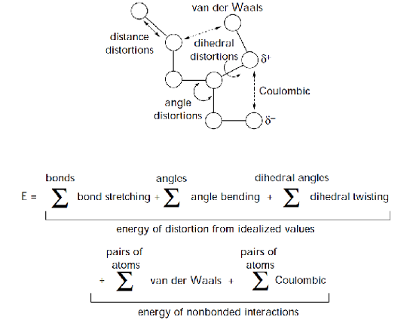
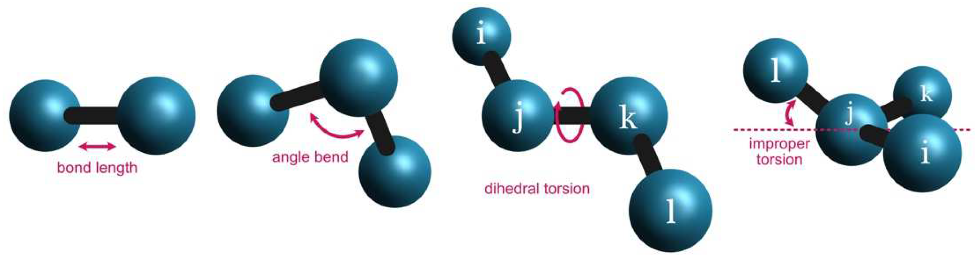
Molecular Mechanics(MM)
MM describes molecules in terms of “bonded atoms”, which have been distorted from some idealized geometry due to non bonded van der Waals and Coulombic interactionsecular Dynamics
Molecular Mechanics methods are based on the following Principles
  Interactions are based as spring and models
  Atoms-like particles have net charge
  Nuclei and electrons are lumped in atom like particles (BO APPROXIMATION)
$$E=E_{\text{covalent}}+E_{\text{noncovalent}}$$

Slide 10
Advantages
They are sufficiently fast (extensive conformational searching on molecules containing upwards of 100-200 atoms)
Empirical energy functions parameterized against experimental data
MM computations are quite inexpensive (compared to ab initio methods), and they allow to be used to compute properties for very large systems containing many thousands of atoms such as:
  Energy optimization
  Calculation of binding constants
  Simulating of protein folding kinetics
  Examination of active site coordinates
  Design of binding site

Slide 11
Limitation
MM calculations reveal nothing about bonding or, more generally, about electron distributions in molecules.(dominant electronic effect )
Each force field achieves good results only for limited class of molecules related to those for which it was parameterized.
Currently available force fields have not been parameterized to handle non-equilibrium forms, in particular, reaction transition states.

Slide 12
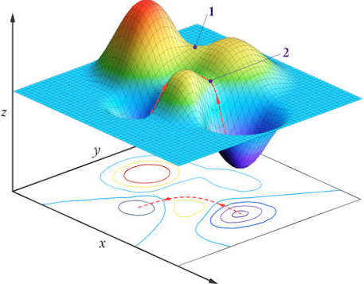
Potential Energy Surfaces
Potential Energy Surfaces: A mathematical or graphical landscape that maps the total potential energy of a molecular system (usually a collection of atoms) based on the spatial positions or geometric coordinates of its nuclei.
Analysis of molecular geometry and chemical reaction dynamics.
WHY PES?
  The Born-Oppenheimer Approximation
  Chemical Reactions
  Dimensionality: For a non-linear molecule(3𝑁−6)

Slide 13
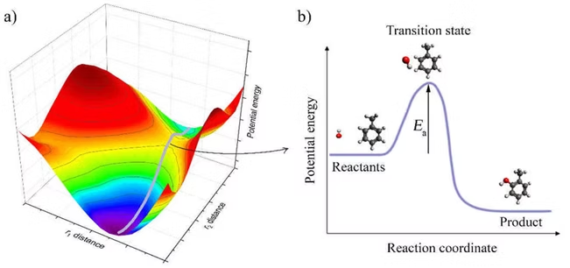
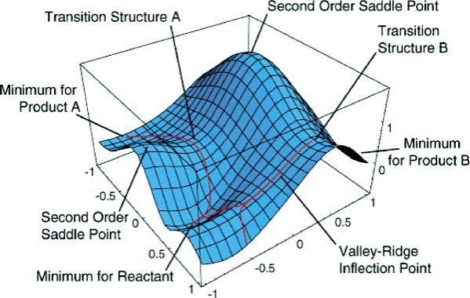
Potential Energy Surfaces
PES do not show kinetic energy, only potential energy.
At T = 0 K (no KE), species will want to be at the lowest possible potential energy, (i.e., at a minimum on the PES).
Between any two minima (valley bottoms) the lowest energy path will pass through a maximum at a saddle point, which we call that saddle point a transition-state structure.

Slide 14
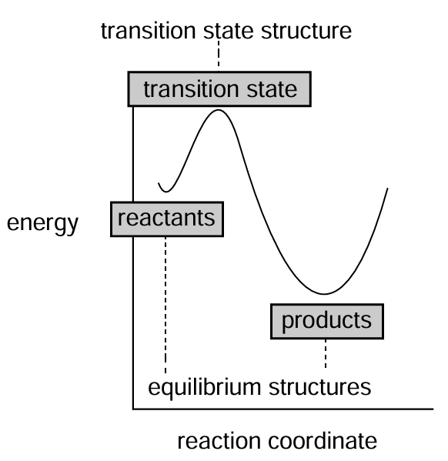
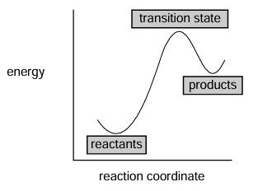
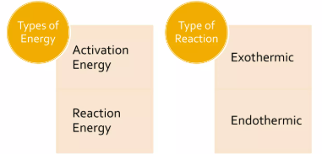
Energy Profile Diagram (EPD)
EPD: a graph that shows how the energy of a chemical system changes as reactants turn into products during a reaction
These diagrams like this (“reaction coordinate” diagrams) provide essential connections between important chemical observables –
  structure
  stability
  reactivity and selectivity
  energy.
Energy minima correspond to equilibrium structures.
The energy maximum corresponds to a transition state structure.

Slide 15
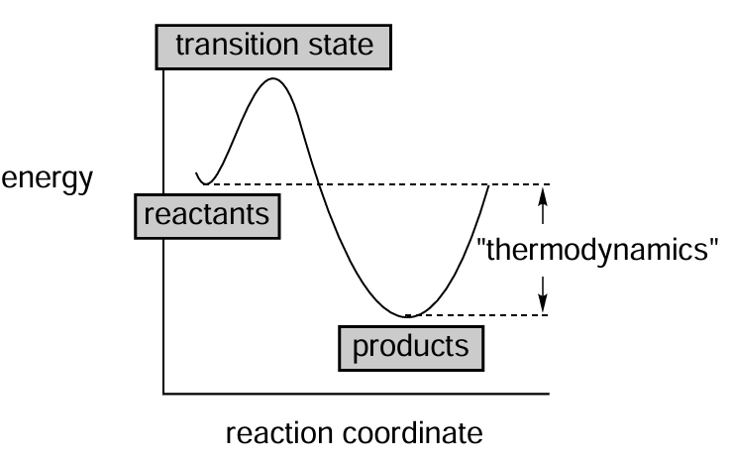
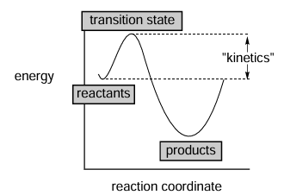
Energy Profile Diagram (EPD)
The energy of the transition state relative to the equilibrium structures provides information about the relative difficulties going on between them (the kinetics of reaction, + ve Gibbs free).
It is the kinetically-favored pathway leading to the kinetic product.
The relative energies of equilibrium structures give the relative stabilities of the reactant and product (the thermodynamics of reaction, - ve Gibbs free).
It is the thermodynamically-favored pathway leading to the thermodynamic product.

Slide 16
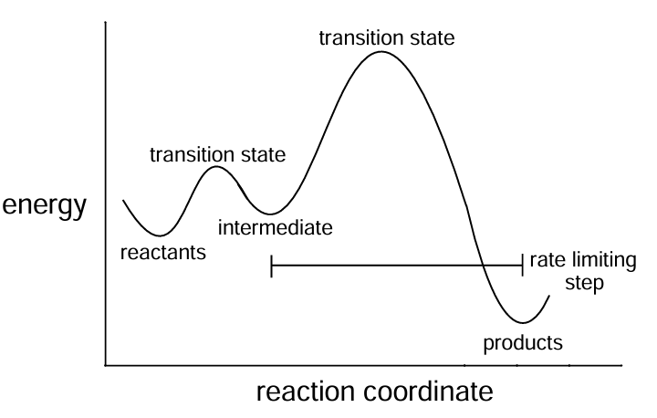
Energy Profile Diagram (EPD)
A complete reaction pathway may comprise several steps and involve several different transition states and high-energy reactive intermediates.
Such a diagram describes the mechanism of a reaction, the rate-limiting step for which proceeds via the highest-energy transition state.
NOTE: By varying conditions (temperature, reaction time, solvent) chemists can affect the product distribution.

Slide 17

Basis Sets
It refers to the set of (nonorthogonal) one-particle functions used to build molecular orbitals, built from mathematical equations
STO Basis Functions
  Correct cusp behavior (finite derivative) at r → 0
  Desired exponential decay at r ∞
  Correctly mimic the H atom orbitals
  Would be more natural choice
  No analytic method to evaluate the coulomb and XC (or exchange) integrals
  they are hard to compute
GTO Basis Functions
  Wrong cusp behavior (zero slope) at r → 0
  Wrong decay behavior (too rapid) at r ∞
  Analytic evaluation of the coulomb and XC (or exchange) integrals (The product of the gaussian "primitives" is another gaussian.)
  They are fast and combined with STO

Slide 18
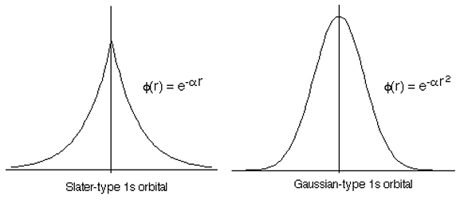
Types Of Basis Sets
Minimal: One basis function (STO, GTO, or CGTO) for each atomic orbital in the atom
Double-zeta: Two basis functions for each atomic orbital
Triple-zeta: Three basis functions for each atomic orbital
Split-valence basis: uses only one basis function for each core atomic orbital, and a larger basis for the valence atomic orbital
Polarized Basis Sets: Add higher-angular-momentum functions (polarization functions) to let orbitals shift and distort during bonding.
Diffuse Basis Sets: Add loosely bound functions with small exponents to describe electrons far from the nucleus, helpful for anions or excited states and binding energies of van der Waal

Slide 19
Solving a problem
Review literature to find functionals that work well for similar systems and properties.
Compare candidate functionals based on their strengths and weaknesses.
Consider basis sets, as performance depends on the functional–basis set combination.
Run calibration tests on small systems to check accuracy before large calculations.
Custom functionals and level of theories are possible, but require deep understanding of basis set, effective core potentails,exchange interaction and Electron Correlation.
Continuously verify with literature to avoid costly mistakes.

Slide 20
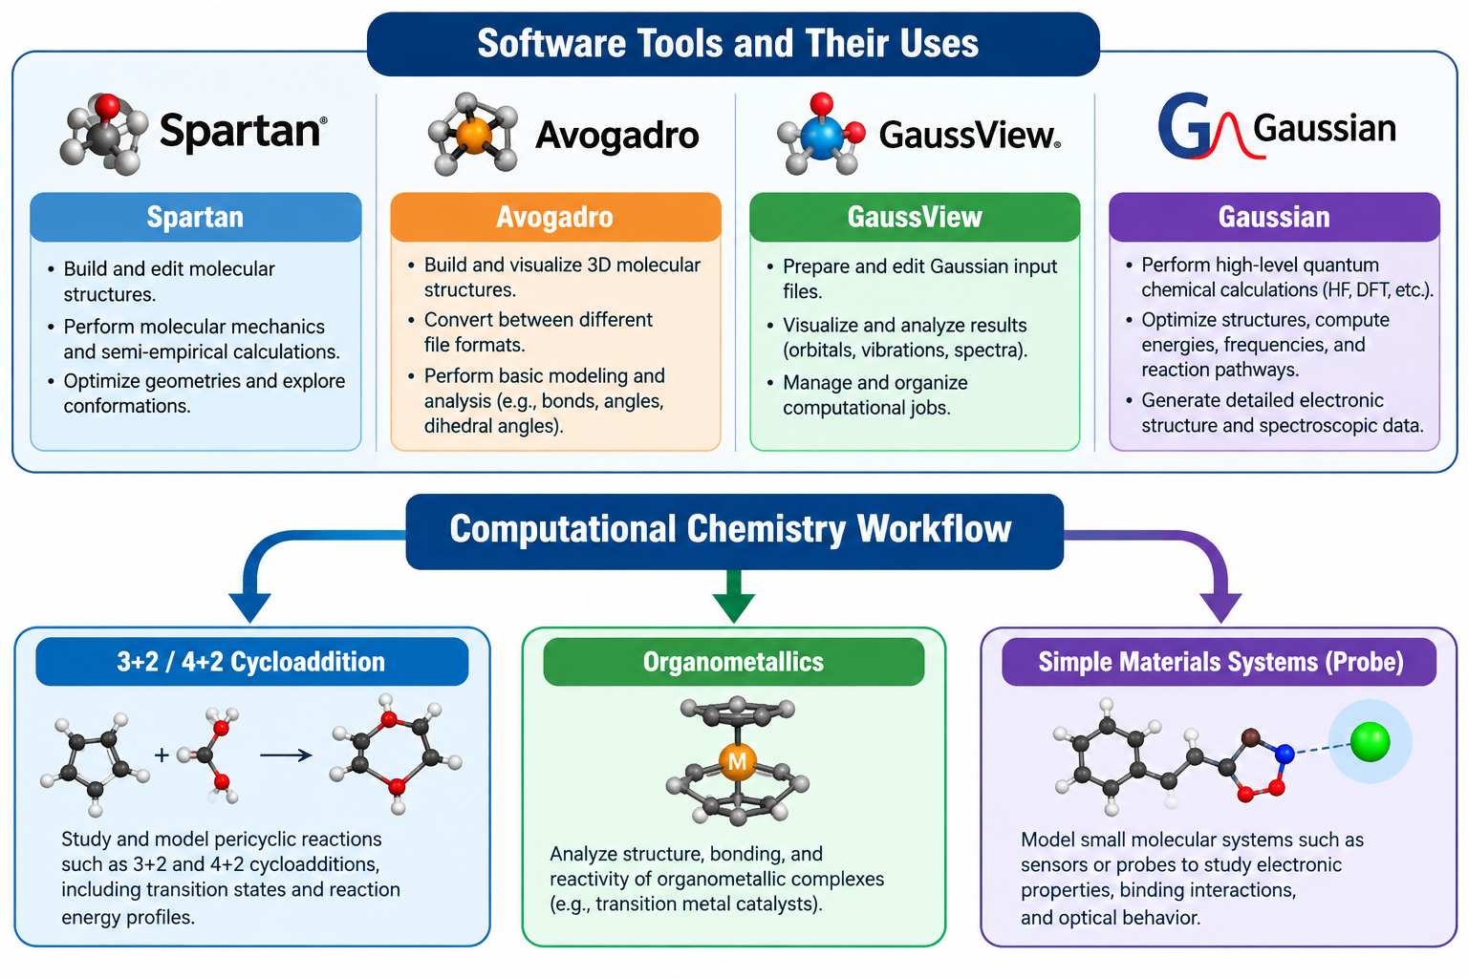
What We Do?

Slide 21
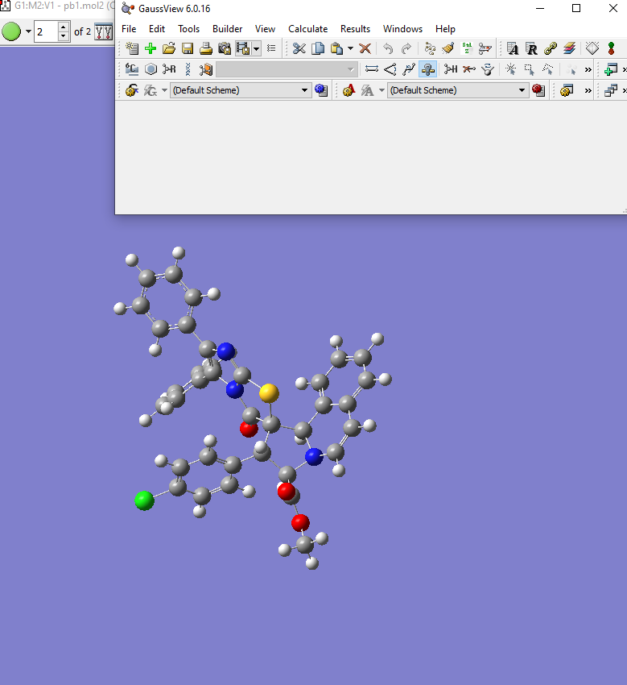
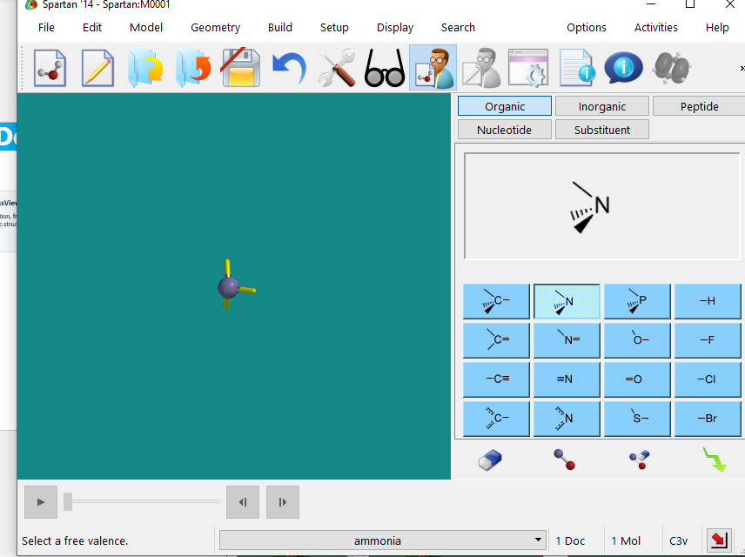
What We Do?
Spartan
Gaussian / GaussView
Model building, conformational exploration, visualization and accessible setup of electronic-structure calculations; useful for introducing students to computational workflows.
Geometry optimization, frequencies, single-point energies, TS searches, IRC,DFT scans and many electronic-structure properties.

Slide 22
Hands-on Session
  Build an advanced computational workflow using tools to solve cycloaddition and organometallic problems

Slide 23

Kwame Nkrumah University of
Science & Technology, Kumasi, Ghana
Thank you
End of Presentation

